Slide 1
MALIGNANT COMMENTS CLASSIFICATION PROJECT

Slide 2
Problem Statement
The proliferation of social media enables people to express their opinions widely online. However, at the same time, this has resulted in the emergence of conflict and hate, making online environments uninviting for users. Although researchers have found that hate is a problem across multiple platforms, there is a lack of models for online hate detection.
Online hate, described as abusive language, aggression, cyberbullying, hatefulness and many others has been identified as a major threat on online social media platforms. Social media platforms are the most prominent grounds for such toxic behaviour.
There has been a remarkable increase in the cases of cyberbullying and trolls on various social media platforms. Many celebrities and influences are facing backlashes from people and have to come across hateful and offensive comments. This can take a toll on anyone and affect them mentally leading to depression, mental illness, self-hatred and suicidal thoughts.
Internet comments are bastions of hatred and vitriol. While online anonymity has provided a new outlet for aggression and hate speech, machine learning can be used to fight it. The problem we sought to solve was the tagging of internet comments that are aggressive towards other users. This means that insults to third parties such as celebrities will be tagged as unoffensive, but “u are an idiot” is clearly offensive.
Our goal is to build a prototype of online hate and abuse comment classifier which can used to classify hate and offensive comments so that it can be controlled and restricted from spreading hatred and cyberbullying.

Slide 3
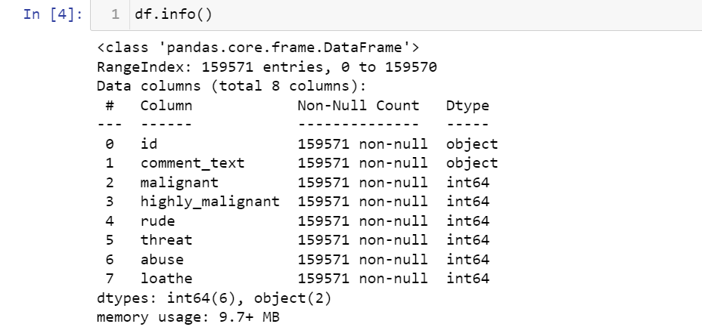
Exploratory Data Analysis
Shape of the data:
Null values present:
The dataset has no null values.
Data set is provided by the FlipRobo technologies and it has 159571 rows and 8 columns.
Following are the columns present and there respective data types:

Slide 4
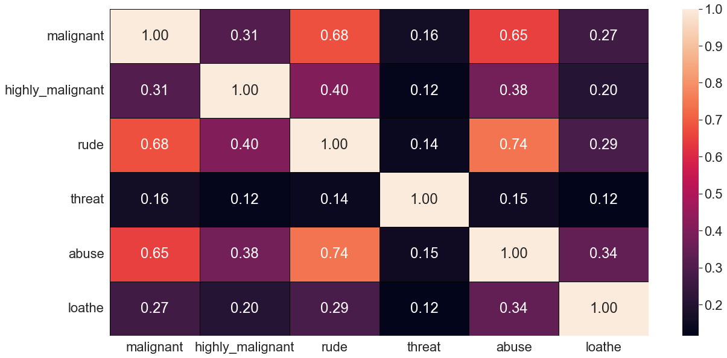
The dataset had no null values but there is a feature called comment_text that contains the comment posted on any social
media, so we need to study this feature very hard and performed various feature engineering technique on it.
We generated heatmap in order to check relation between features but could’nt found any multicollinearity problem here.

Slide 5
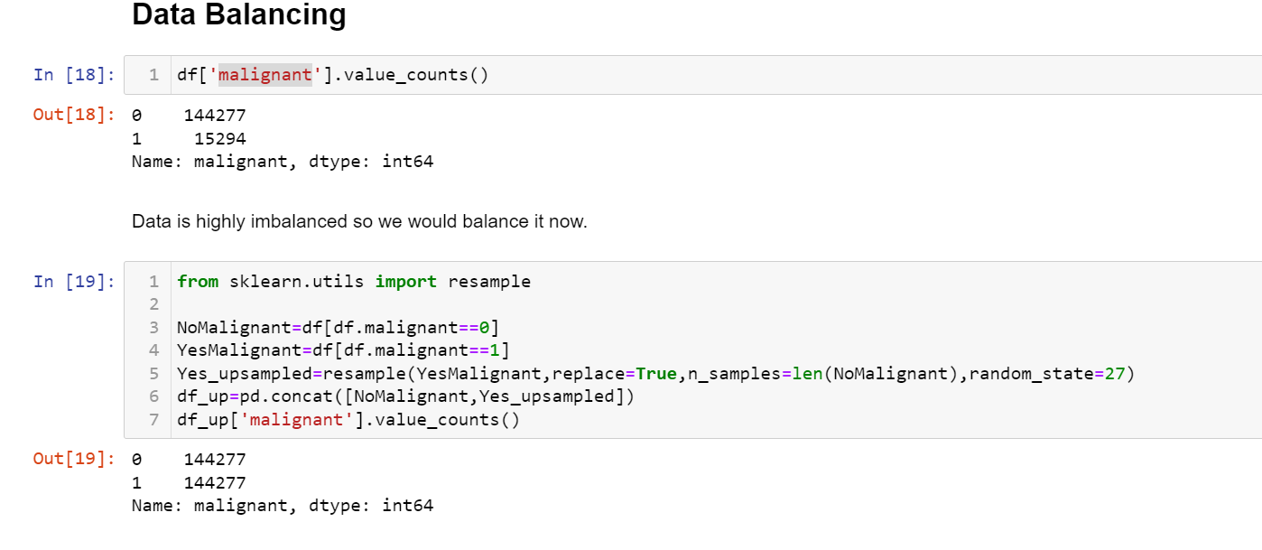
We found out that the data was imbalanced so we balanced the data by performing upsampling technique on it.

Slide 6
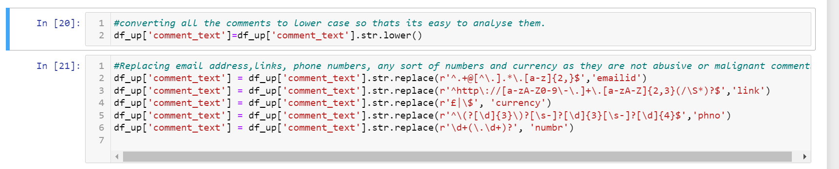
Feature Engineering-We have to fetch abusive, rude words from the comment so in order to do that we first converted entire comment_text
feature to lower case then replaced all the phone numbers, email ids, URL’s, any sort of number and currency by phno,emailed,link,numbr and
currency respectively.

Slide 7
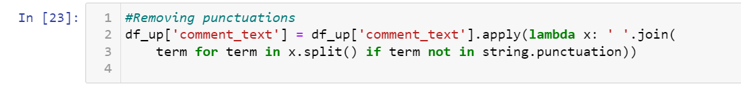
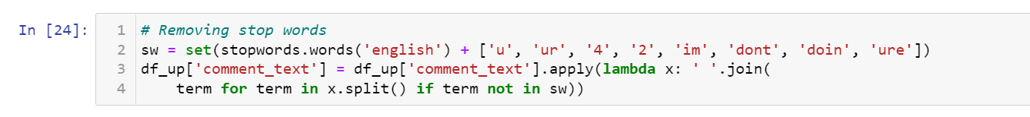
Further we removed all kinds of punctuations from the feature comment_text.
In order to fetch just the abusive words we also have to remove all kind of stop words.

Slide 8
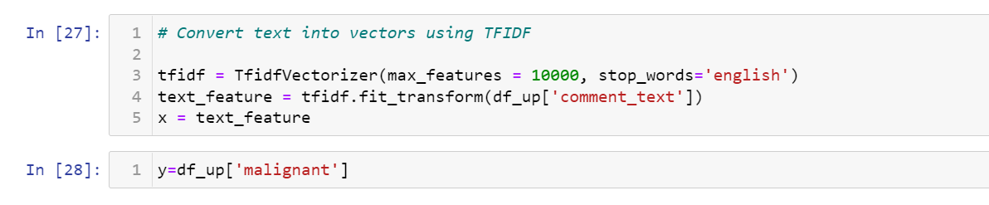
In order to further analyse the comment_text using morphological analysis of the words called lemmatization.
Then finally we converted the comment_text into its vector form Term Frequency and Inverse Document Frequency method.

Slide 9
We split the data into training set and testing set using train test split method.
On this train and test data we applied various models: logistic regression, decision tree classifier, random forest classifier , Knn classifier.
The best performing model is random forest as its confusion matrix, auc-roc curve and recall, f1-score is the best among all. Since the model is already giving its best accuracy so we won’t apply hyperparameter tuning as it’s a very big data so applying hyperparameter tuning is very time consuming and the scope of accuracy improvement is very less.
So, we saved our previous random forest classifier model.

Slide 10
Analysing relationship between features

Slide 11
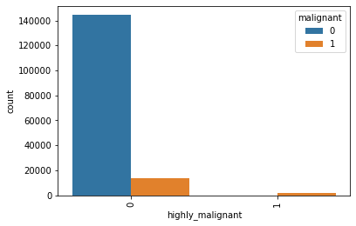
Here we can see that if highly_malignant is true then the comment has to be malignant but in few cases if highly_maglinant is not true still the comments are malignant .

Slide 12
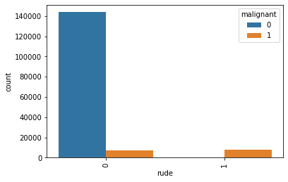
If the comment is rude then there are higher chances that it is malignant and vice-versa.

Slide 13
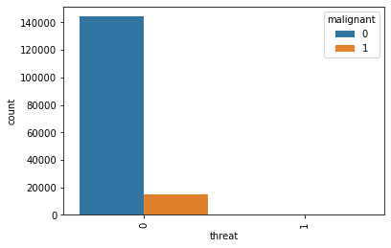
We could observe that the threat value is always 0 but still at some cases even if threat value is 0, malignant value is 1.

Slide 14
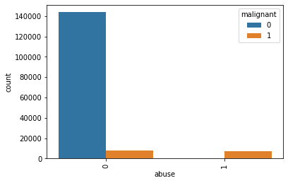
We could observe that at maximum times when abuse is 0, malignant is 0 as well.

Slide 15

We could observe that at maximum times when loathe is 0, malignant is 0 as well.

Slide 16
Hardware and Software Requirements and Tools Used
We imported following packages:
import pandas as pd
import numpy as np
import matplotlib.pyplot as plt
import seaborn as sns
from sklearn.preprocessing import OrdinalEncoder
from sklearn.preprocessing import LabelEncoder
from statsmodels.stats.outliers_influence import variance_inflation_factor
from scipy.stats import zscore
from sklearn.model_selection import GridSearchCV
from sklearn.preprocessing import StandardScaler
from sklearn.preprocessing import power_transform
from sklearn.model_selection import train_test_split
from sklearn.model_selection import cross_val_score
from sklearn import metrics
from sklearn.metrics import roc_curve,auc,classification_report
from sklearn.feature_extraction.text import TfidfVectorizer
import warnings
warnings.filterwarnings('ignore')
from nltk.stem import WordNetLemmatizer
import nltk
from nltk.corpus import stopwords
import string
Further we downloaded stopwords and wordnet module as well.

Slide 17
Run and Evaluate selected models

Slide 18
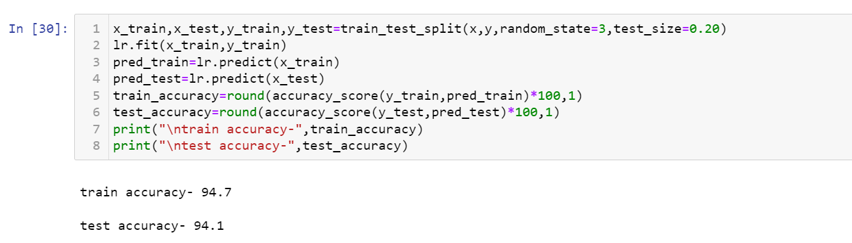
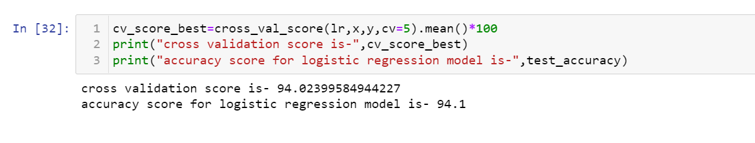
Logistic Regression
We applied this algorithm and found the train accuracy to be 94.7% and test accuracy to be 94.1%.
The test accuracy for logistic regression is 94.1% and its cv score is 94.02% thus making us sure that the model is not overfitted.

Slide 19
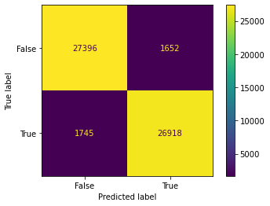
Confusion matrix:
Model is good in predicting both the classes

Slide 20
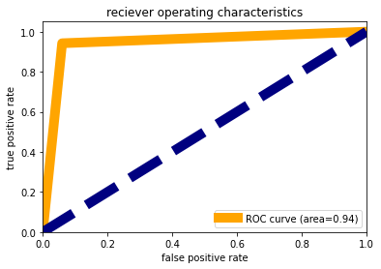
AUC-ROC Curve
We observed that the area under the curve is 94% that means 94% times model is predicting accurately and rest all
other time it gives wrong prediction.

Slide 21
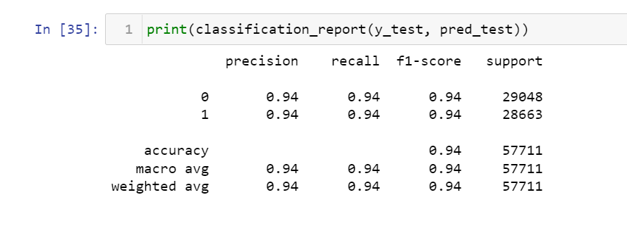
Classification Report
Precision, recall and f1-score is same for both the classes.

Slide 22
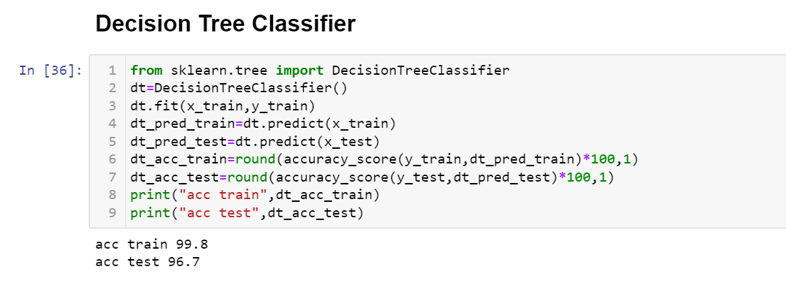
Decision Tree Classifier
We applied this algorithm and found the train accuracy to be 99.8% and test accuracy to be 96.7%.

Slide 23
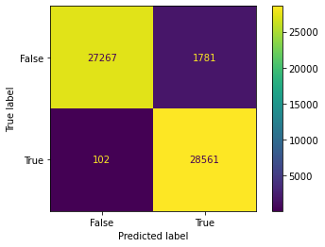
Confusion matrix:
Model is bad in predicting false classes but good in predicting true classes.

Slide 24
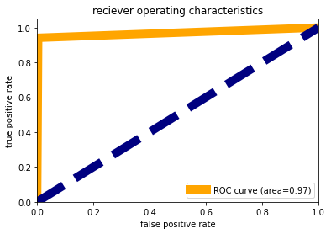
AUC-ROC Curve:
We observed that the area under the curve is 97% that means 97% times model is predicting accurately and rest all other
time it gives wrong prediction. This accuracy is a good one lets check on other metrics as well.

Slide 25
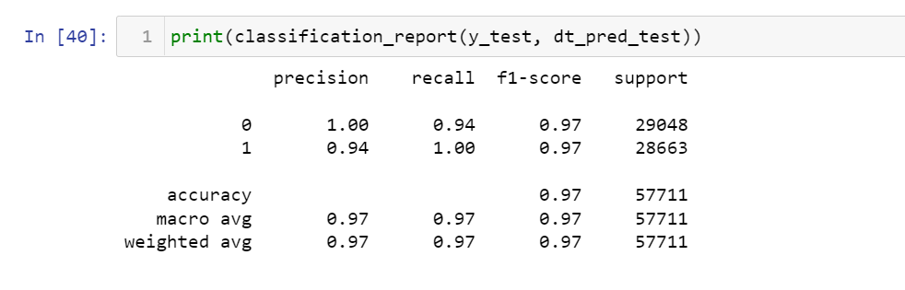
Classification Report:
Model is poor in recalling class 1 i.e., True than class 0 i.e. False, although precision for class 1 is higher than class 0.
F1-score of class 0 is similar to that of class 1.

Slide 26
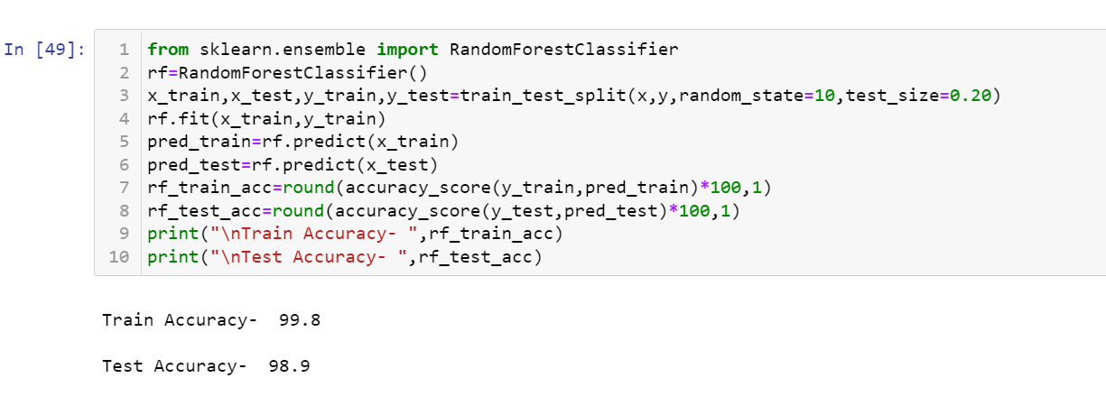
Random Forest Classifier
We applied this algorithm and found the train accuracy to be 99.8% and test accuracy to be 98.9%.

Slide 27
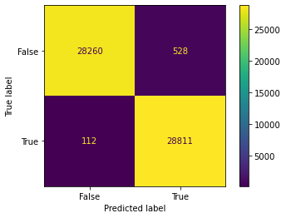
Confusion matrix:
Model is equally good in predicting both the classes.

Slide 28
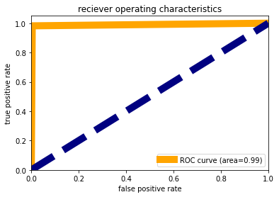
AUC-ROC Curve:
We observed that the area under the curve is 99% that means 99% times model is predicting accurately and rest all other time
it gives wrong prediction. This accuracy is a good one let’s check on other metrics as well.

Slide 29
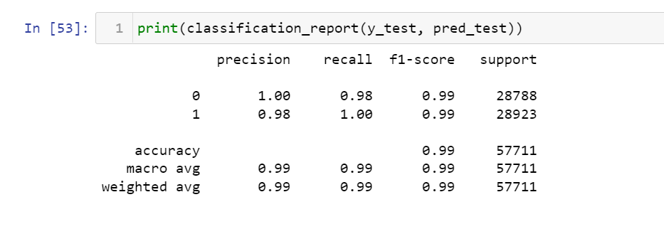
Classification Report:
Model is poor in recalling class 1 i.e., True than class 0 i.e. False, although precision for class 1 is higher than class 0. F1-score of
class 0 is similar to that of class 1.

Slide 30
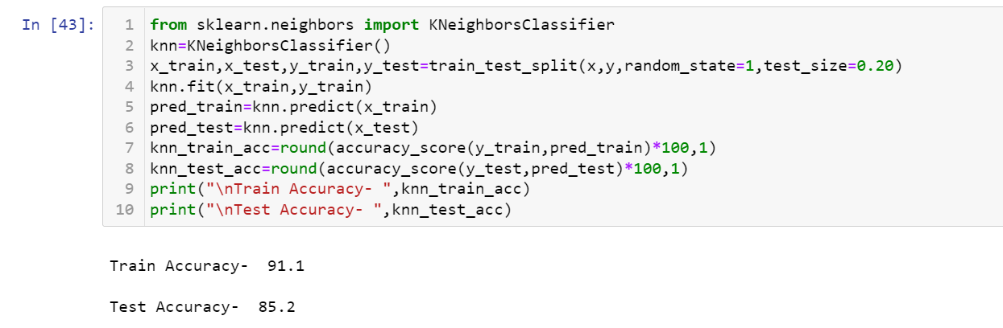
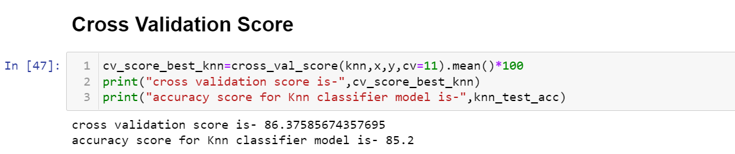
Knn Classifier
We applied this algorithm and found the train accuracy to be 91.2% and test accuracy to be 85.2%.
The test accuracy for logistic regression is 85.2% and its cv score is 86.3% thus making us sure that the model is not overfitted,
although decision tree classifier is prone to overfitting.

Slide 31
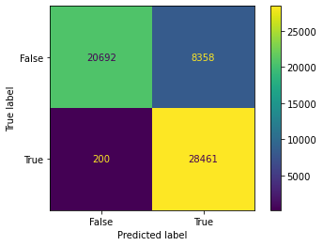
Confusion matrix:
Model is good in predicting false classes but bad in predicting true as well as false classes. Although we can also see that
the samples for true classes and samples for false classes are also equal.

Slide 32
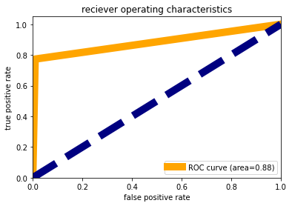
AUC-ROC Curve:
We observed that the area under the curve is 88% that means 88% times model is predicting accurately and rest all
other time it gives wrong prediction. This accuracy is a good one let’s check on other metrics as well.

Slide 33
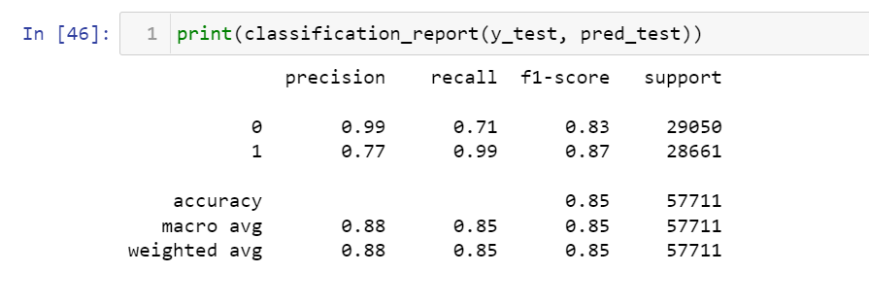
Classification Report:
Model is poor in recalling class 1 i.e., True than class 0 i.e. False, although precision for class 1 is higher than class 0.
F1-score of class 0 is similar to that of class 1.

Slide 34
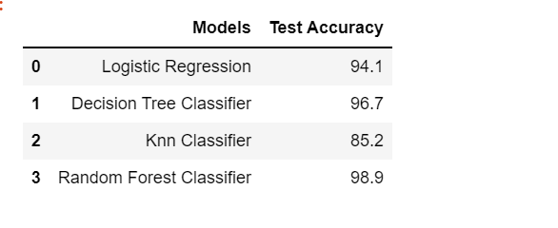
Conclusion for Model
There are three models with least difference between accuracy and cv score but the best performing model is random forest as its confusion matrix, auc-roc curve and recall, f1-score is the best among all. Since the model is already giving its best accuracy so we wont apply hyperparameter tuning as it’s a very big data so we will save our random forest model.

